Slide 1
new business opportunities
in the 21st century
Mauro F. Guillén

Slide 2
2030

Slide 3
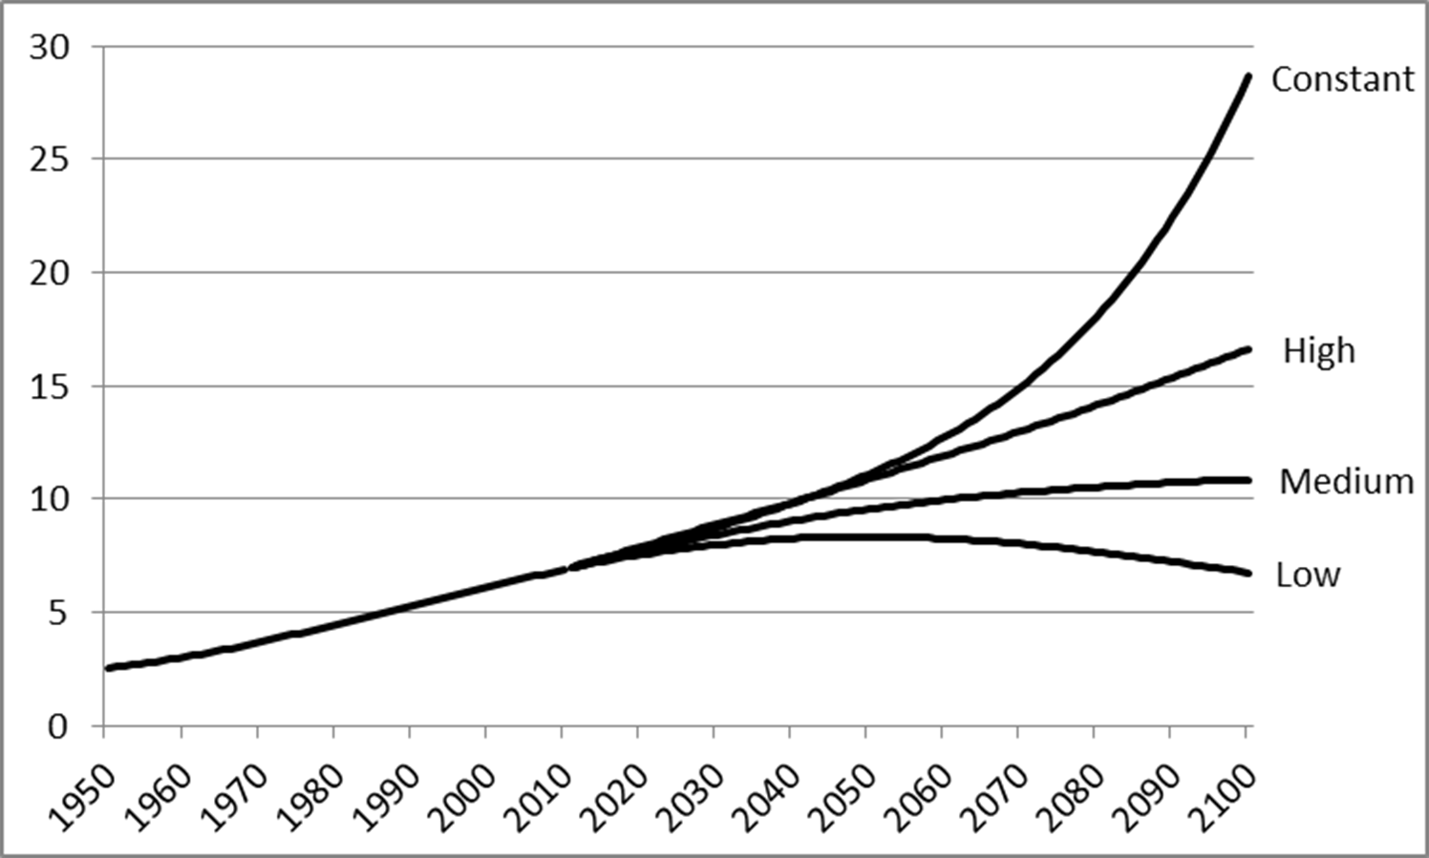
World population 1950-2100
Source of the data: United Nations Population Division, World Population Prospects: The 2012 Revision.

Slide 4
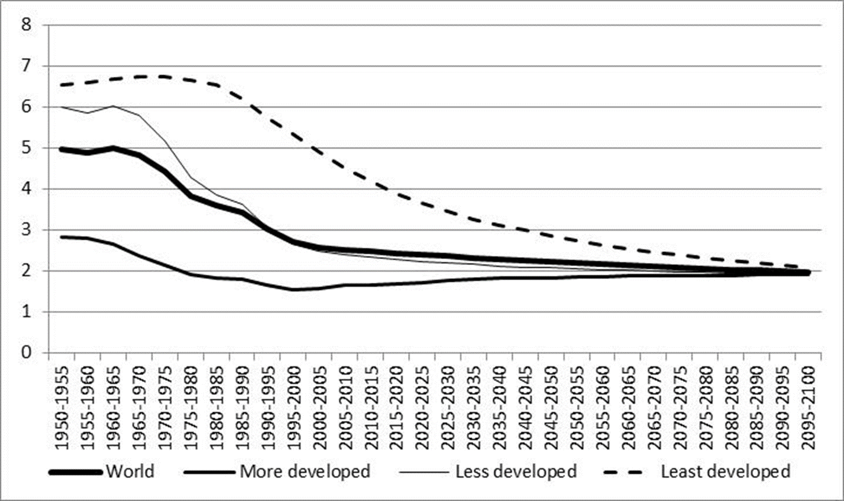
Declining Fertility
(children per woman)
Note: A total fertility rate of 2.1 children per woman is generally considered to be necessary for population replacement.
Source: United Nations Population Division, World Population Prospects: The 2012 Revision.

Slide 5
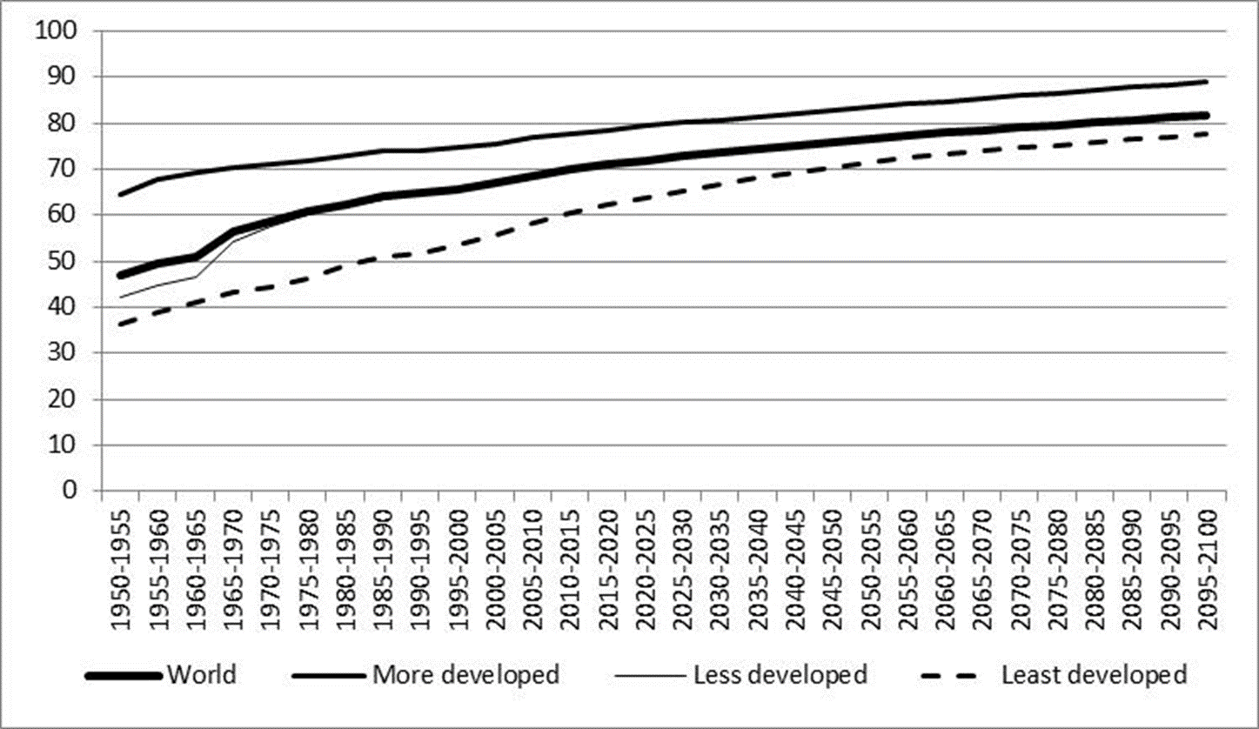
Rising Life Expectancy (in years)
Source: United Nations Population Division, World Population Prospects: The 2012 Revision.

Slide 6
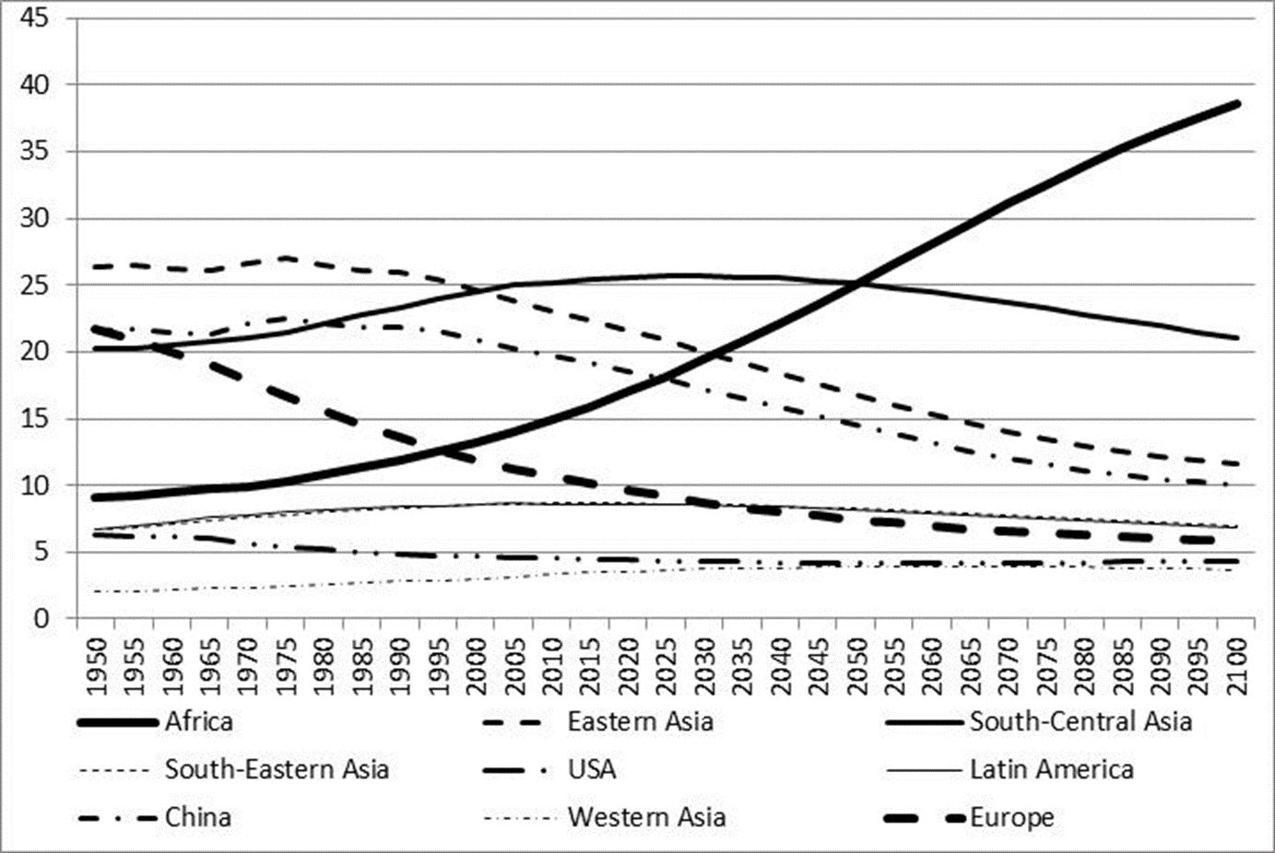
Regional Distribution (%)
Source: United Nations Population Division, World Population Prospects: The 2012 Revision.

Slide 7
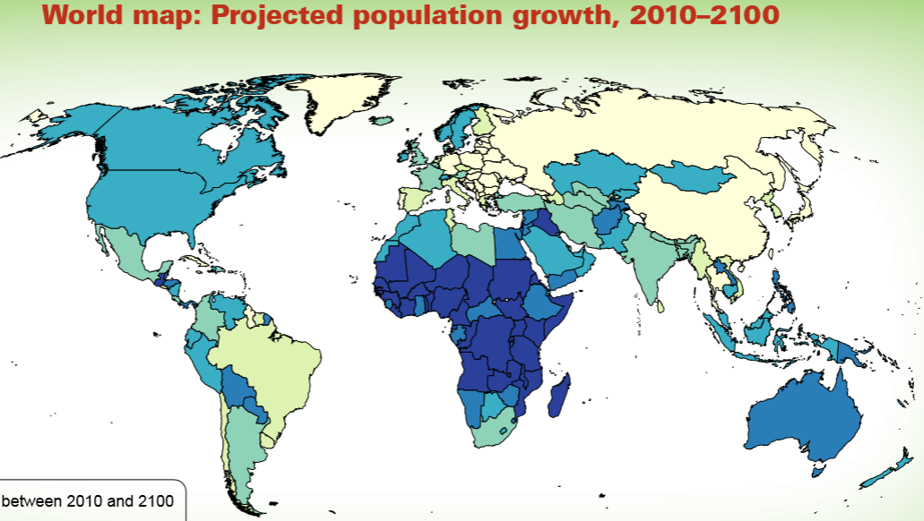
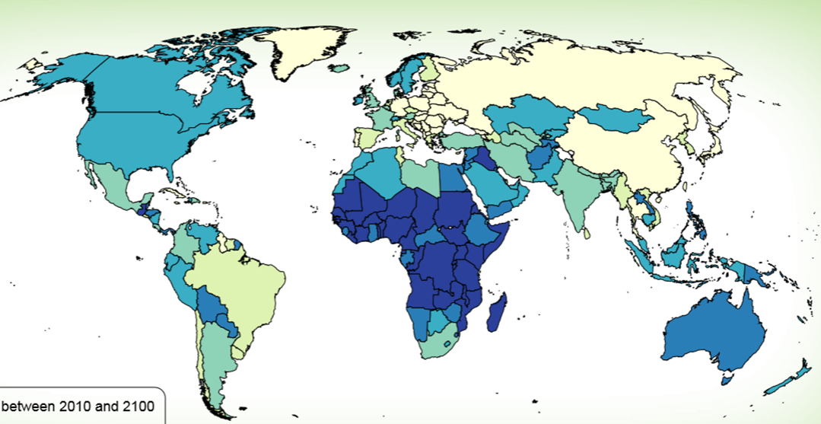
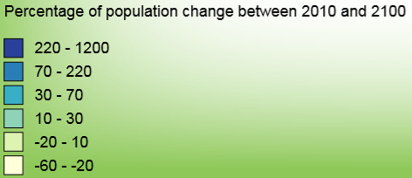
PROJECTED POPULATION GROWTH, 2010–2100
Source: United Nations Population Division,
World Population Prospects: The 2012 Revision.

Slide 8
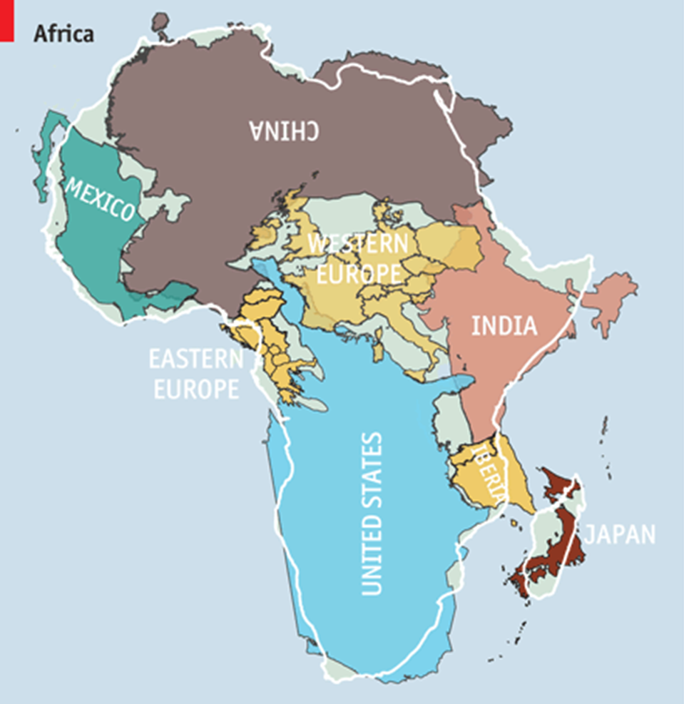
Source: United Nations Population Division, World Population Prospects: The 2012 Revision.

Slide 9
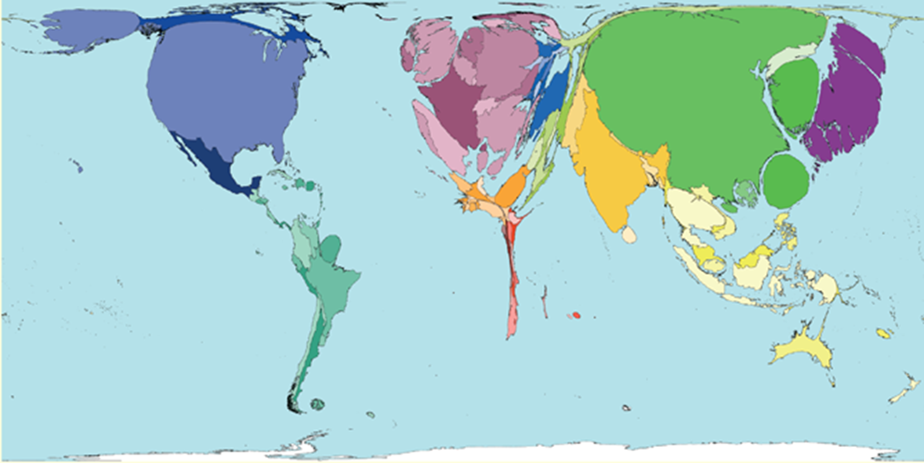
Relative economic size
Source: www.worldmapper.org

Slide 10
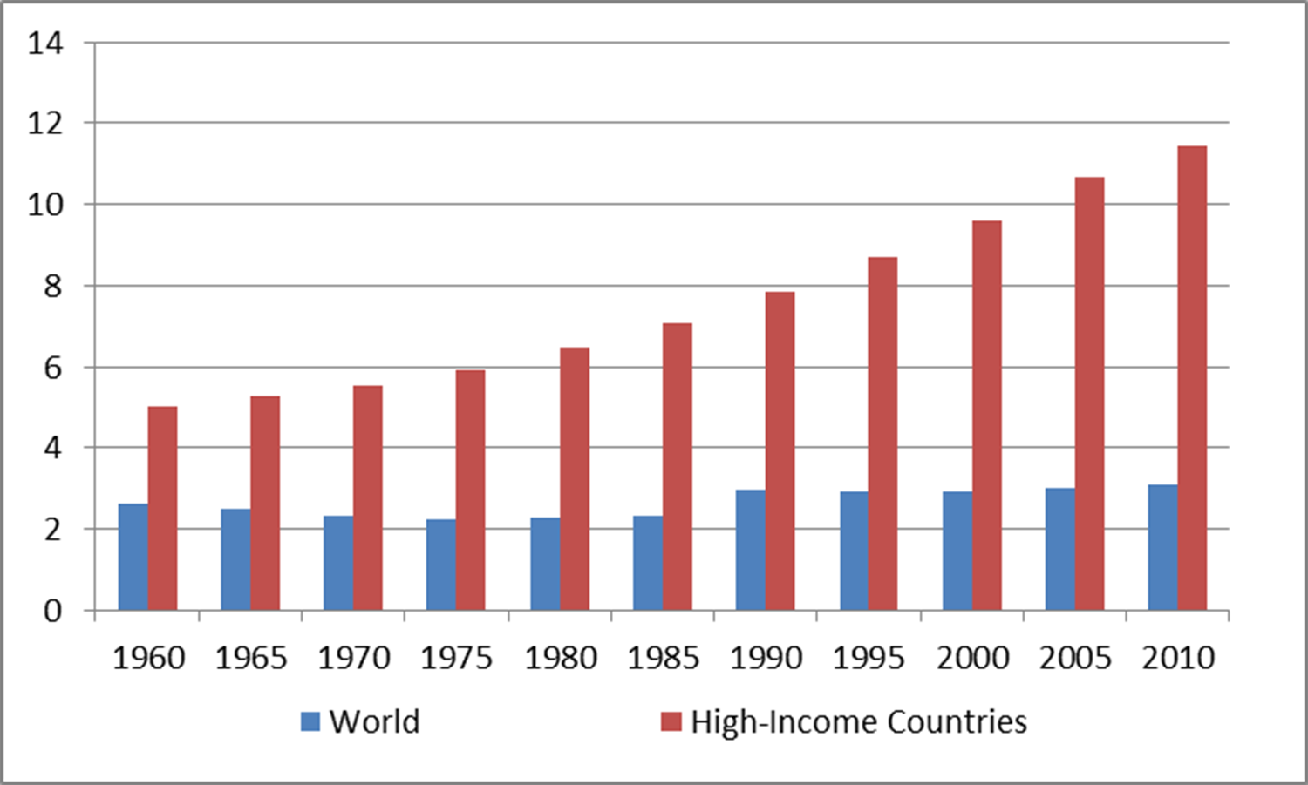
Immigrants (% of population)
Mauro F. Guillén.
Source of the data: World Development Indicators.

Slide 11
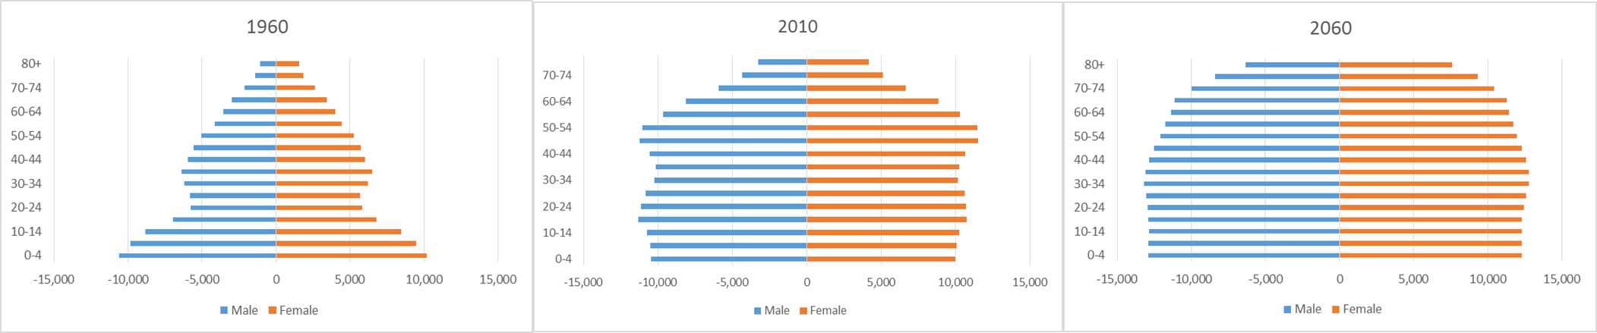
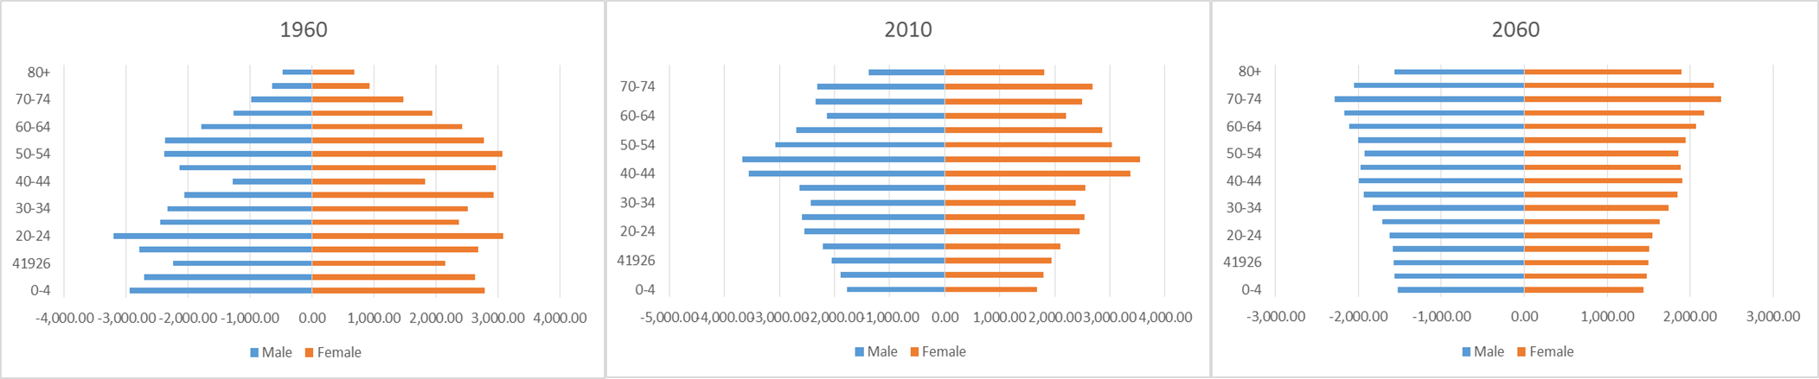
United States
Germany
Source: Population Division, United Nations.

Slide 12
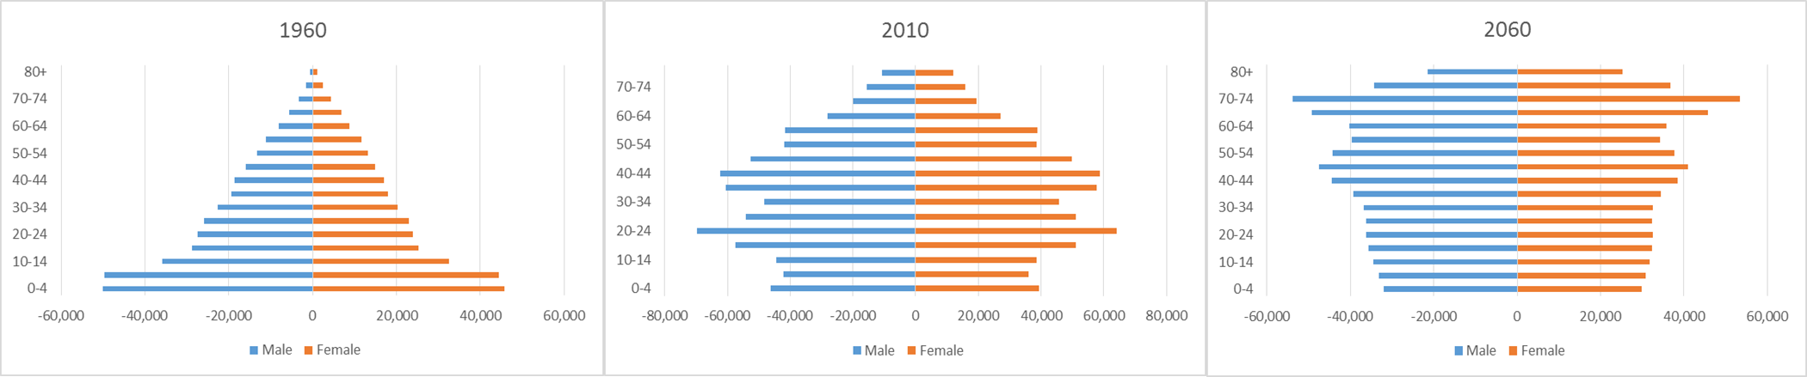
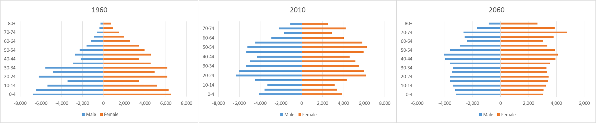
CHINA
RUSSIA
Source: Population Division, United Nations.

Slide 13
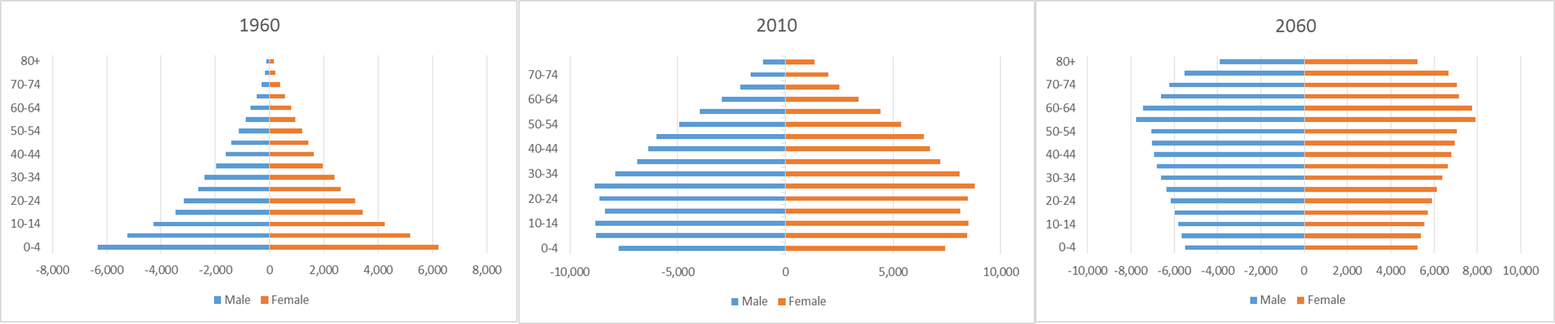
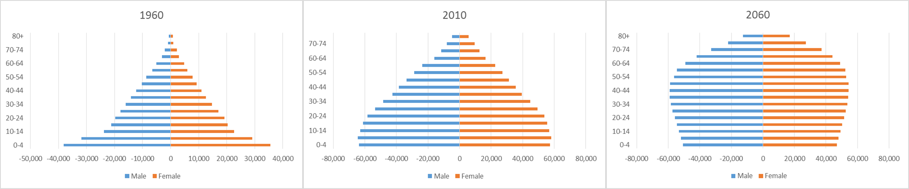
BRAZIL
INDIA
Source: Population Division, United Nations.

Slide 14
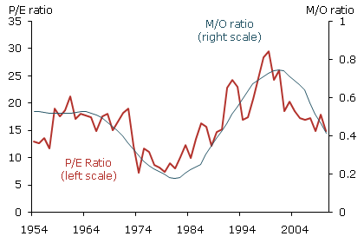
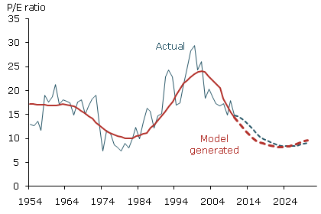
Ageing and Stock Prices
P/E: price/earnings.
M/O: age 40–49/age 60–69.
Source: Zheng Liu and Mark M. Spiegel, “Boomer Retirement: Headwinds for U.S. Equity Markets?” Federal Reserve Bank of San Francisco. http://www.frbsf.org/publications/economics/letter/2011/el2011-26.html

Slide 15
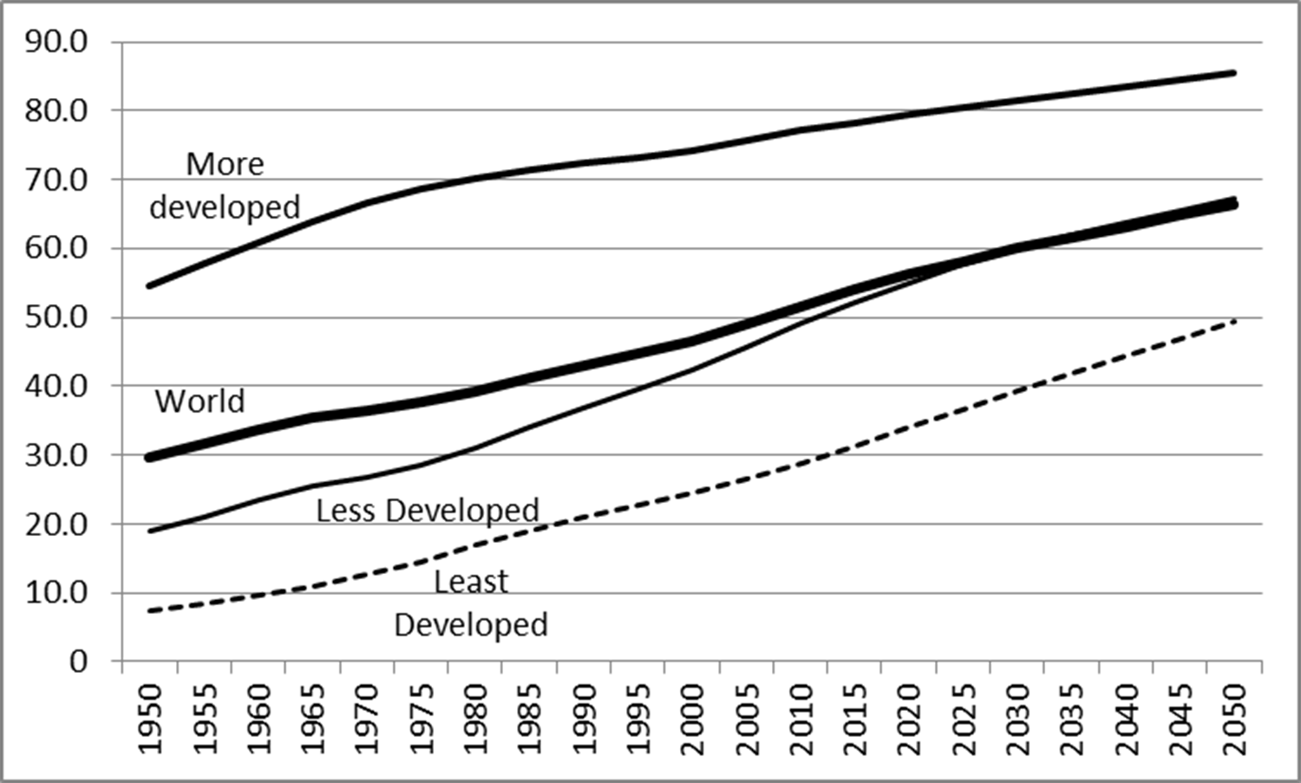
Urbanization (% total population)
Source: United Nations Population Division, World Urbanization Prospects: The 2014 Revision.

Slide 16
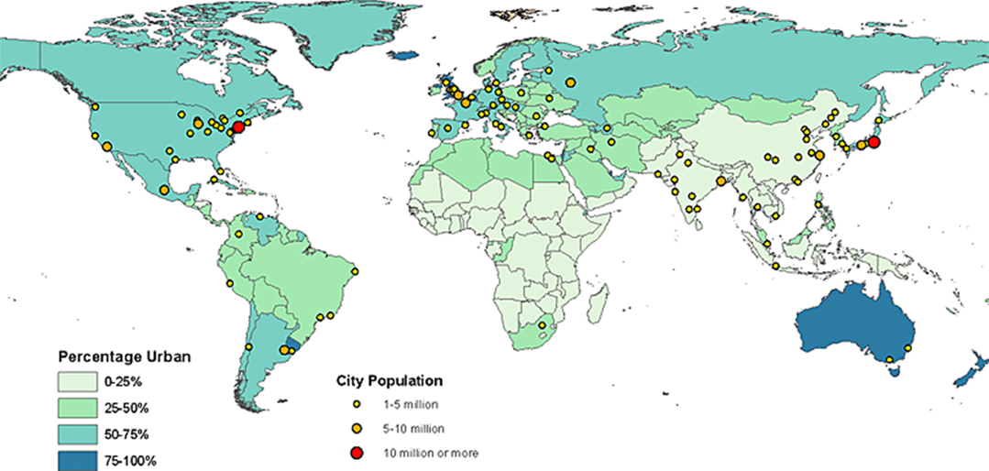
World’s Largest Cities 1960
Source: United Nations Population Division, World Urbanization Prospects, the 2011 Revision.

Slide 17
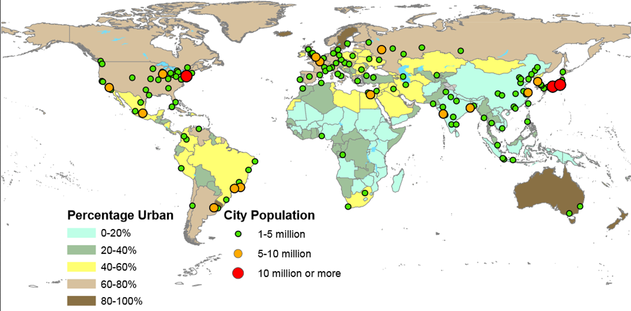
World’s Largest Cities 1970
Source: United Nations Population Division, World Urbanization Prospects, the 2014 Revision.

Slide 18
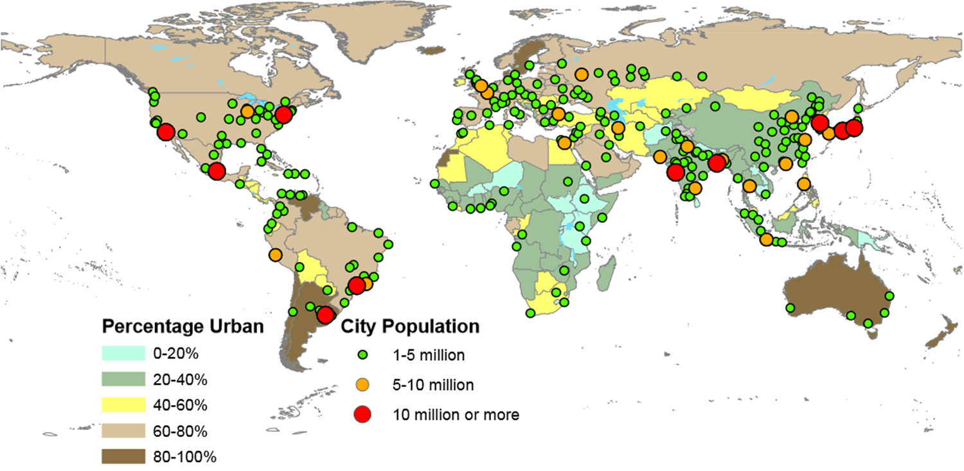
World’s Largest Cities 1990
Source: United Nations Population Division, World Urbanization Prospects, the 2014 Revision.

Slide 19
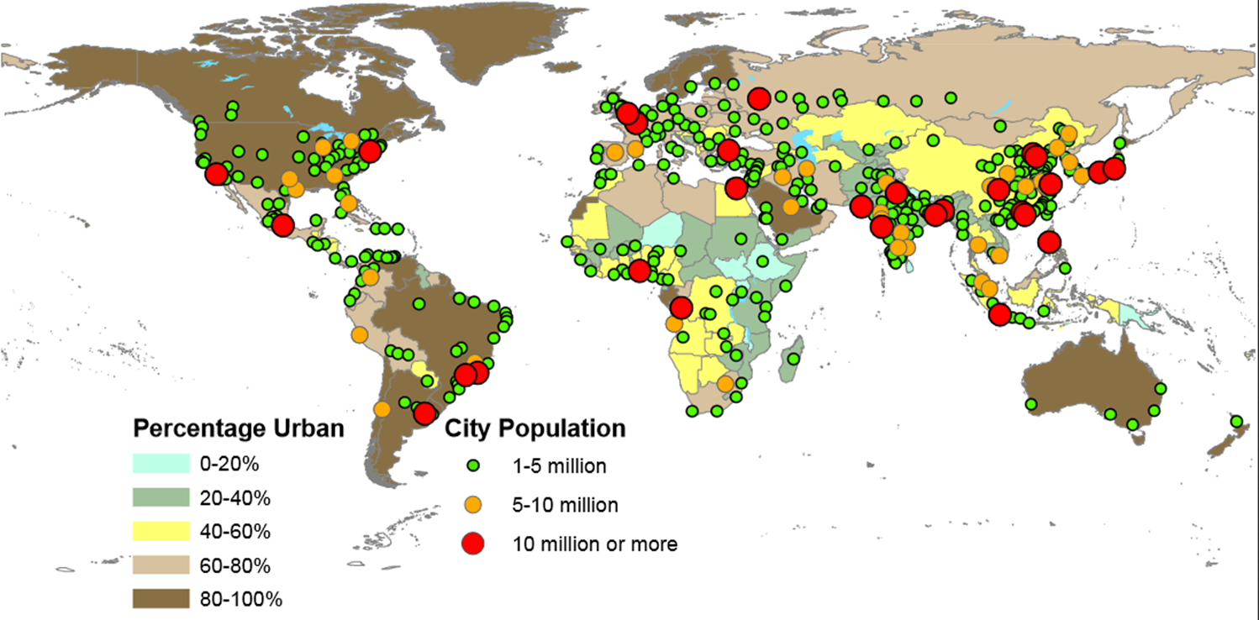
World’s Largest Cities 2014
Source: United Nations Population Division, World Urbanization Prospects, the 2014 Revision.

Slide 20
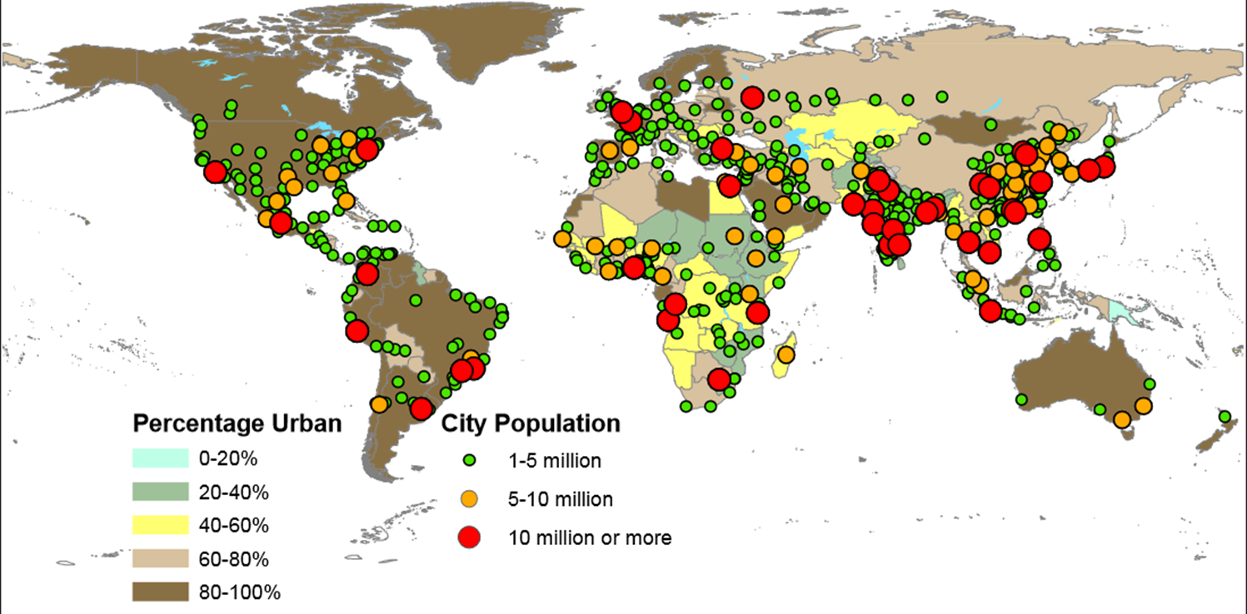
World’s Largest Cities 2030
Source: United Nations Population Division, World Urbanization Prospects, the 2014 Revision.

Slide 21
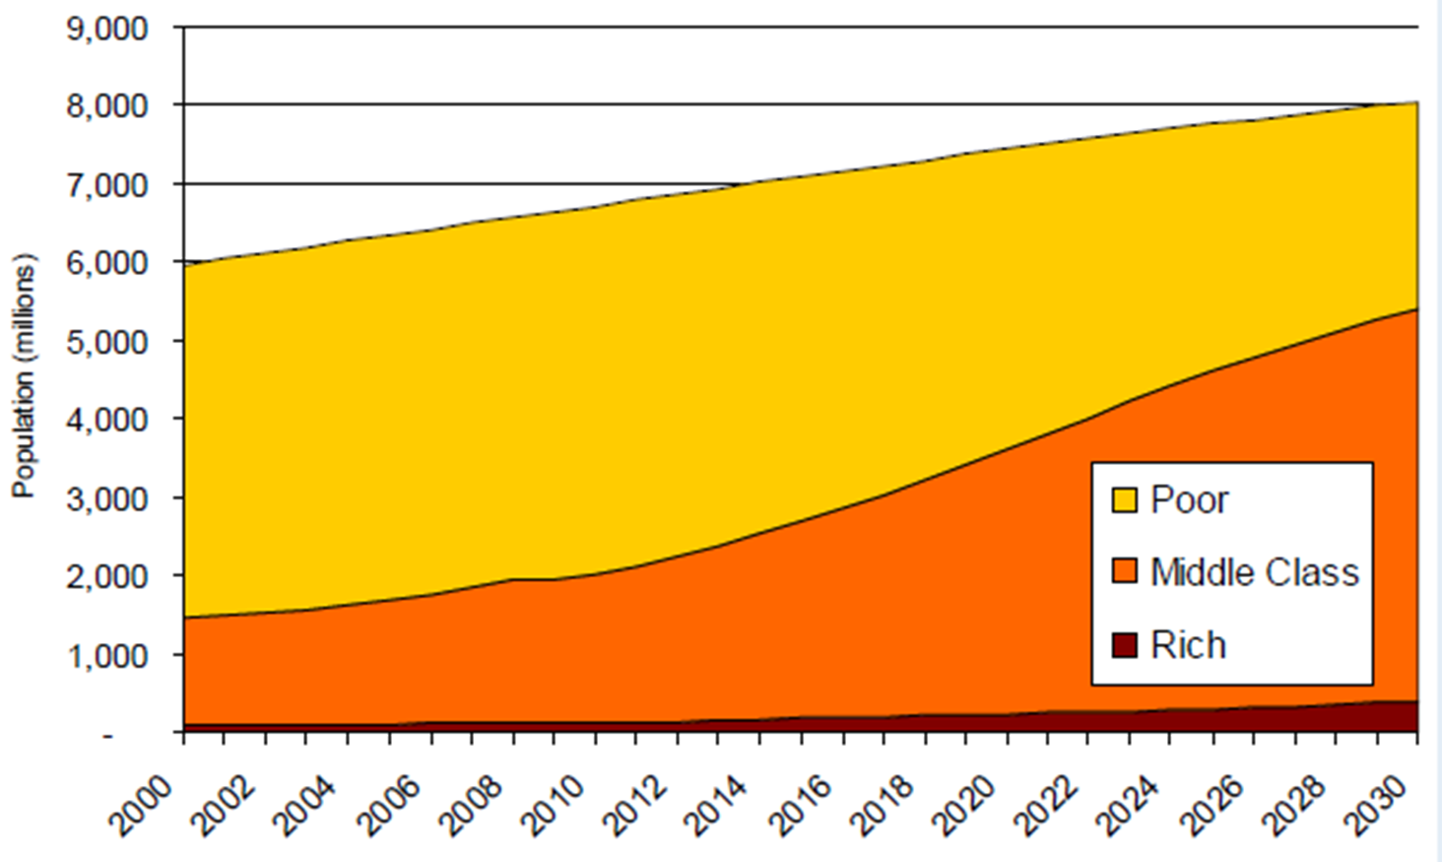
Middle class defined as people with more than $10 per day to spend but less than $100 (using purchasing power parities).
Source: Homi Kharas, The Emerging Middle Class in Developing Countries (Presentation at Brookings, 2011).

Slide 22
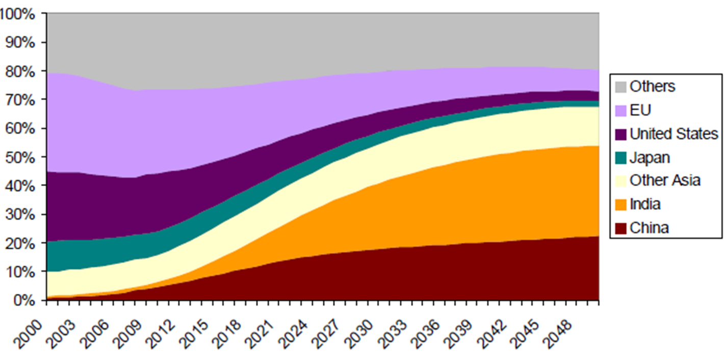
Shares of global middle class consumption, 2000–2050
Source: Homi Kharas, The Emerging Middle Class in Developing Countries (OECD, 2010).

Slide 23
The middle-class, 2009 and 2030
Source: Brookings Development, Aid, and Government Indicators
http://www.brookings.edu/research/interactives/development-aid-governance-indicators (accessed March 15, 2015)

Slide 24
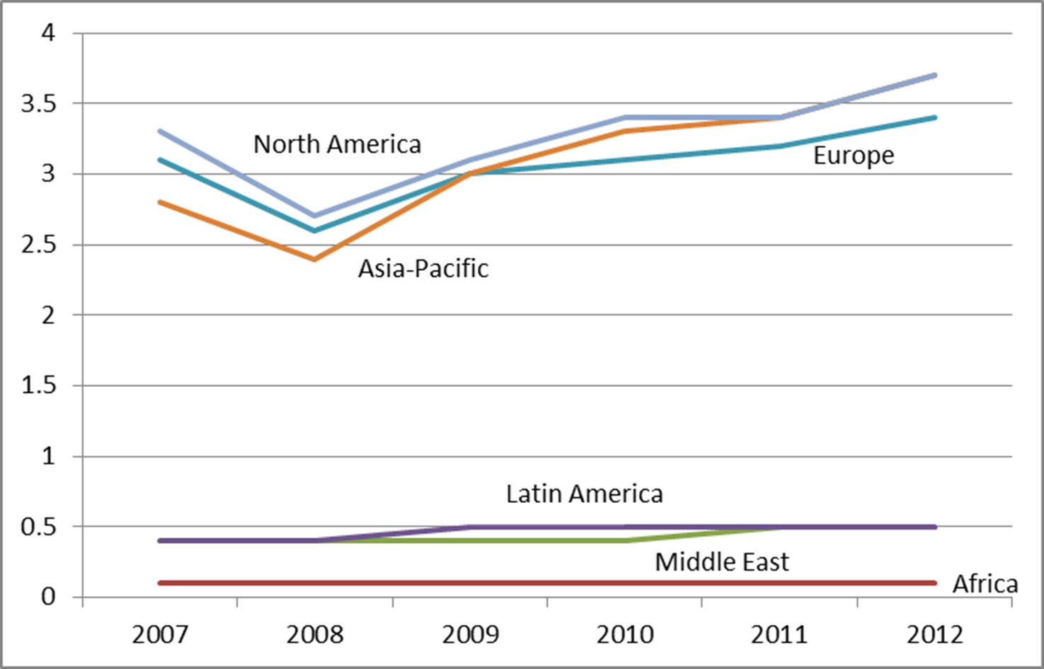
High Net Worth Individuals (millions)
Those with $1 million of investable assets excluding primary residence, collectibles, consumables, and consumer durables.
Source of data: Capgemini and RBC Wealth Management, World Wealth Report 2013.

Slide 25
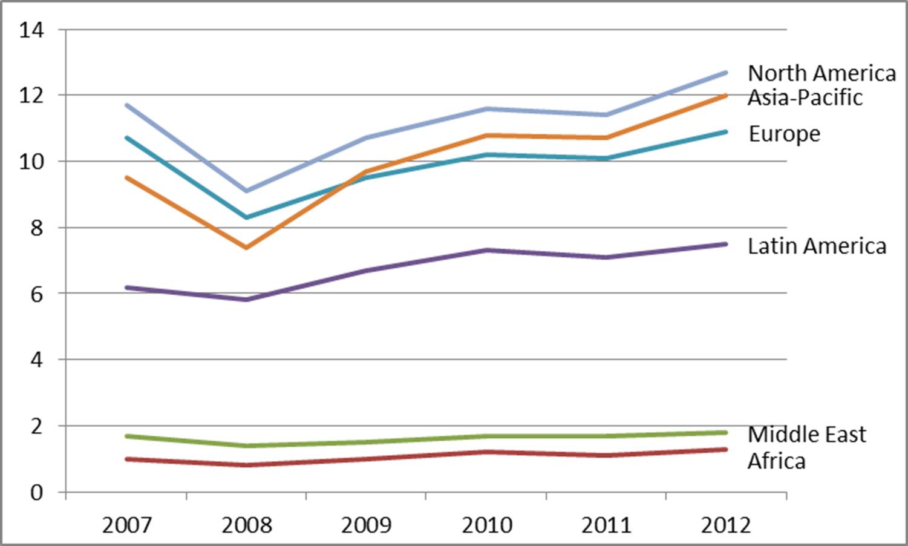
HNWIs’ Wealth ($ trillion)
Source of data: Capgemini and RBC Wealth Management, World Wealth Report 2013.

Slide 26
Country | Number of HNWIs (thousands)
 | 2011 | 2012
USA | 3,068 | 3,436
Japan | 1,822 | 1,902
Germany | 951 | 1,015
China | 562 | 643
UK | 441 | 465
France | 404 | 430
Canada | 280 | 298
Switzerland | 252 | 282
Australia | 180 | 207
Italy | 168 | 176
Brazil | 165 | 165
South Korea | 144 | 160
Source of data: Capgemini and RBC Wealth Management, World Wealth Report 2013.

Slide 27
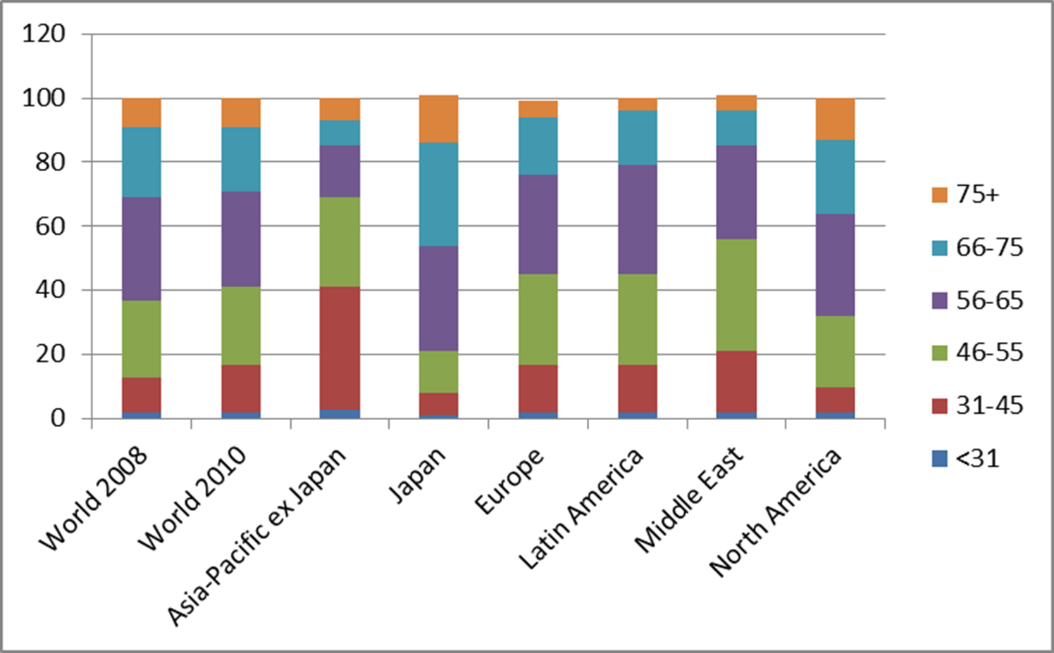
HNWIs by Age
Source of data: Capgemini/Merrill Lynch Global Wealth Management Advisor Surveys 2009, 2011.

Slide 28
Country |  | HNWIs % Women
World 2008 |  | 24
World 2010: |  | 27
North America |  | 37
Japan |  | 31
Asia-Pacific ex Japan |  | 24
Europe |  | 18
Latin America |  | 18
Middle East |  | 14
World 2013 |  | 40*
Source of data: Capgemini/Merrill Lynch Global Wealth Management Advisor Surveys 2009, 2011.
*Capgemini and RBC Wealth Management, World Wealth Report (2013).

Slide 29
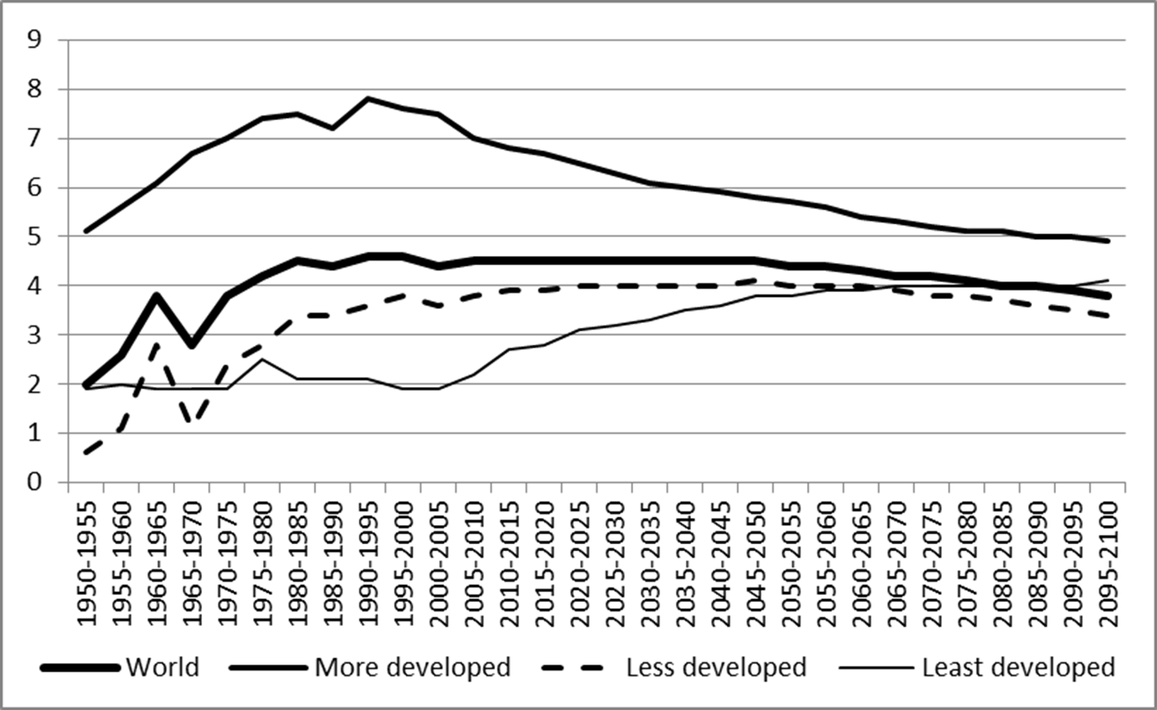
Female Advantage in Life Expectancy (years)
Source of data: United Nations Population Division, World Population Prospects: The 2012 Revision.

Slide 30
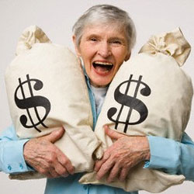

Slide 31

Implications for:
Consumer markets?
Savings behavior?
Financial markets?
Sandro Botticelli, Venus and Mars, c 1483. Tempera on panel, National Gallery, London.

Slide 32
Gender and savings
Complex causes: age, marital status, and social roles.
Single women tend to save more than single men, especially if
they are not expecting to get married soon.
Men save more than women when they are preparing for marriage.
In countries with traditional gender roles, women’s higher
earnings result in higher savings.
In countries with egalitarian gender roles, the reverse is true.
In the U.S. and Canada women contribute less to their
retirement accounts.
Source: S. A. Grossbard and A. Marvao Pereira. 2010. “Will Women Save more than Men? A Theoretical Model of Savings and Marriage.” WP No. 3146. Munich: Ifo Institute for Economic Research.

Slide 33
Gender and risk aversion
Women tend to be more risk averse than men.
The more financially knowledgeable a man, the more risk averse. The opposite is true for women. More educated men and women are more risk averse.
Some surveys and experiments show that women tend to be more risk averted than men when it comes to saving and investing:
  Women underestimate the probability of high-likelihood gains.
  Women are more pessimistic when faced with risky decisions.
Products that appeal to risk-averse investors:
  Exchange-traded funds.
  Investment products with downside protection.
Source: Gary Charness and Uri Gneezy. 2012. “Strong Evidence for Gender Differences in Risk Taking,” Journal of Economic Behavior and Organization 83(1):50-58.

Slide 34
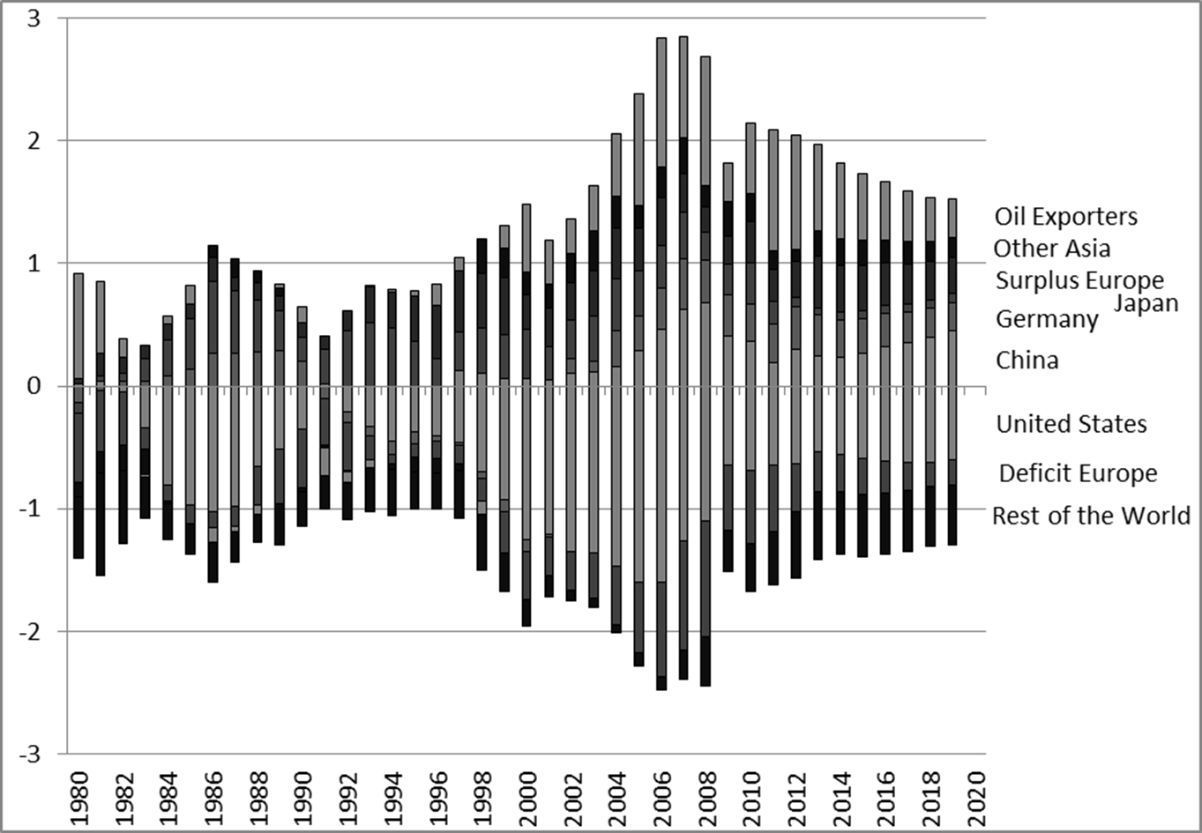
current account imbalances, % world GDP
Mauro F. Guillén. Data from the IMF, Global Economic Outlook.

Slide 35
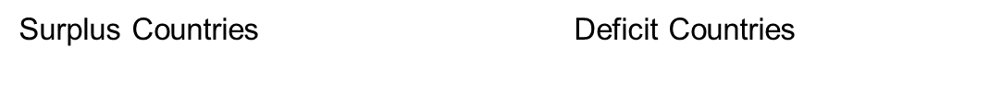
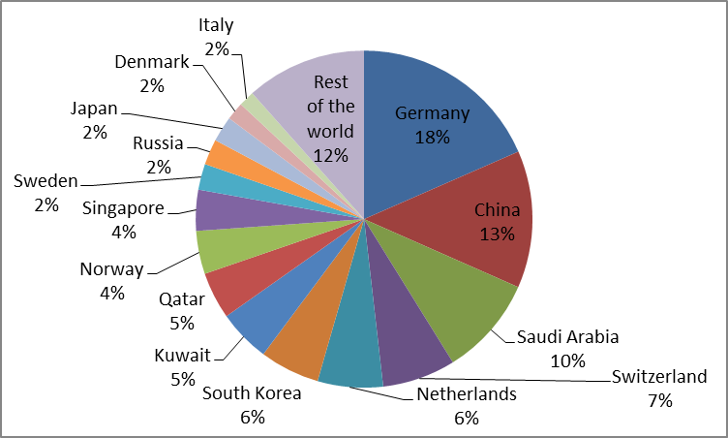
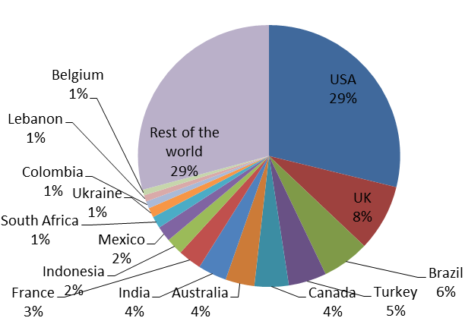
Current accounts and
capital flows, 2013
Mauro F. Guillén. Source of the data: World Development Indicators.

Slide 36
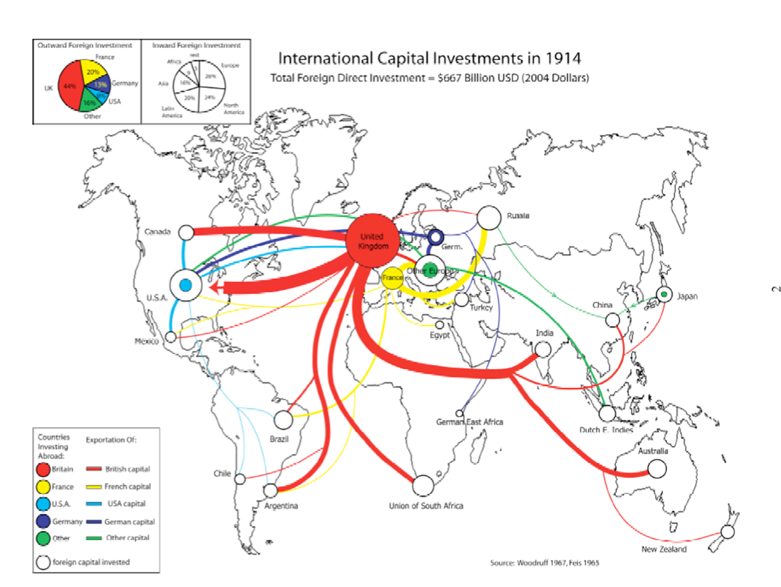

Slide 39
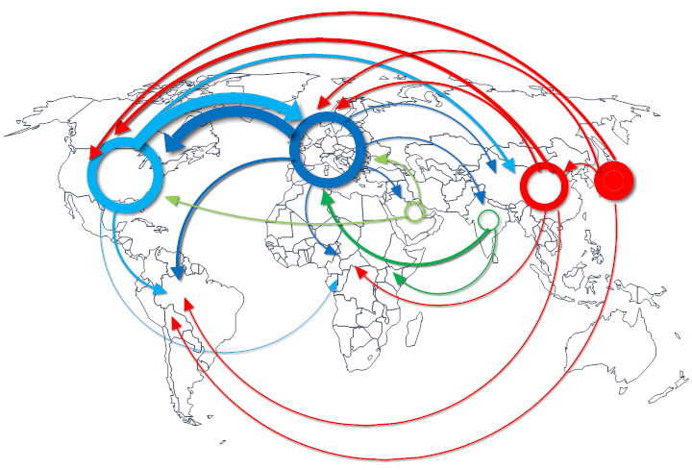
Capital Investments 2012
Mauro F. Guillen. Source of the data: World Investment Report; World Investment Directory.

Slide 40
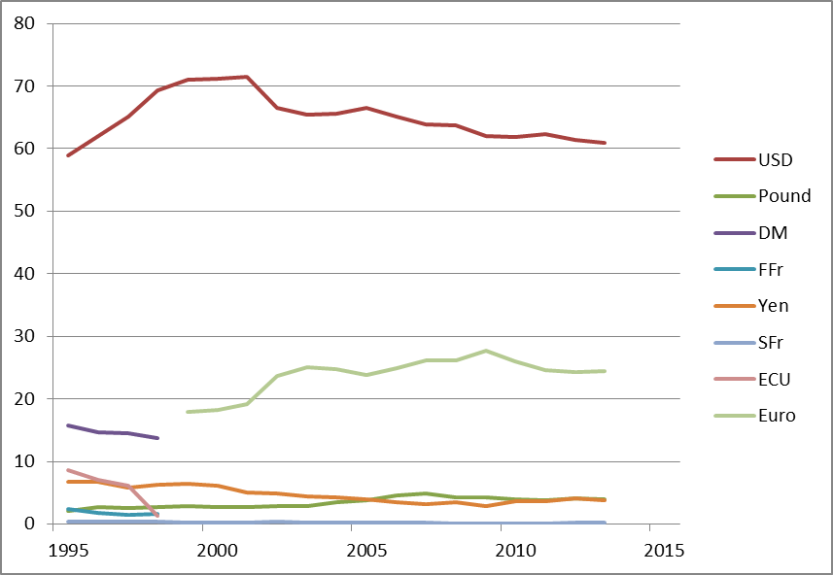
Currency Allocation of Reserves

Slide 41
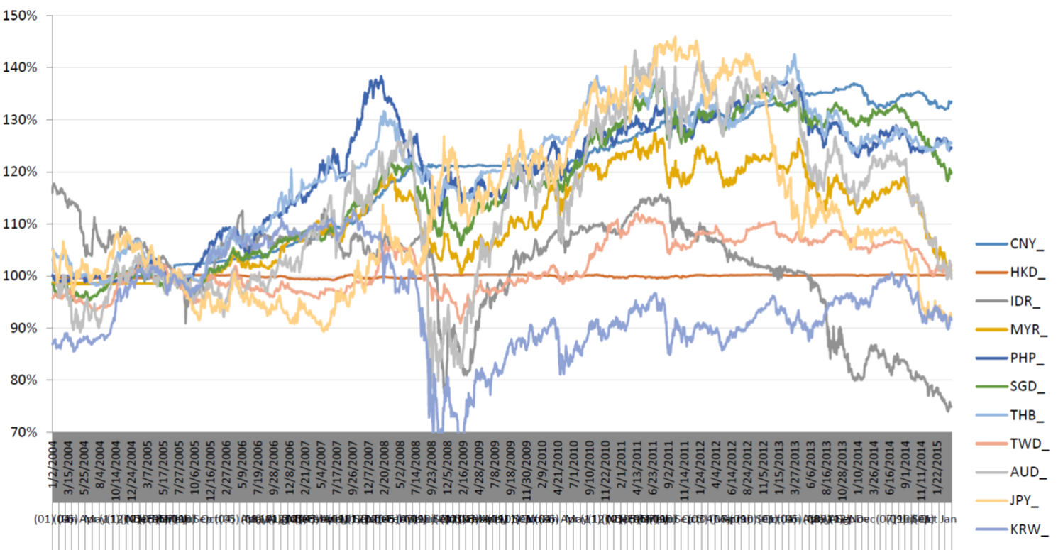
Exchange rates relative to
us dollar

Slide 42
Welcome to the 21st Century
The 21st century will be characterized by:
  Young populations in the most unstable regions, with the most natural resources.
  Older population pyramids in Europe and East Asia.
  A race for natural resources: energy, minerals, food, and water.
  Growing inequality within countries.
  Political instability, failed states, and terrorism.
  Economic & financial volatility.
Global imbalances.
Potential for systemic disruptions.

Slide 43
Contact Information
Mauro F. Guillén
Zandman Professor of International Management
The Wharton School
Director,
The Joseph H. Lauder Institute of Management & International Studies
University of Pennsylvania
212 Lauder-Fischer Hall
256 South 37th Street
Philadelphia, PA 19104-6330
Ph: 215-573-6267
Email: guillen@wharton.upenn.edu
Twitter: @MauroFGuillen
Personal website: www.management.wharton.upenn.edu/guillen

